Slide 1

HOMMY
Politecnico di Torino
Ambient Intelligence 01QZPLZ

Slide 2

A Short Introduction

Slide 3
The Vision
Imagine being at home with some friends tired of watching movies or playing the same games. What about amusing with your own home? Now you and your friends can join an immersive and interactive game to have a great time. Hommy will be the perfect game master! He will be able to provide an innovative way of entertainment to a group of friends or family members!

Slide 4
TEAM

Slide 5
Gianluca Gortan
Aerospace engineering student
Designer (Graphical User interface - Video YT)
Lorenzo Limoli
Computer engineering student
Software Developer (Main Hub code – Server code - Web API – Website – GUI – Games code – Android App)
Pierluigi Vancheri
Computer engineering student
Software Developer (Server code – Android App – Web API - Website)
Mohamad Mostafa
Software Developer (Games Code – Android App)
Electronic and communications engineering student

Slide 6
THE GAME

Slide 7
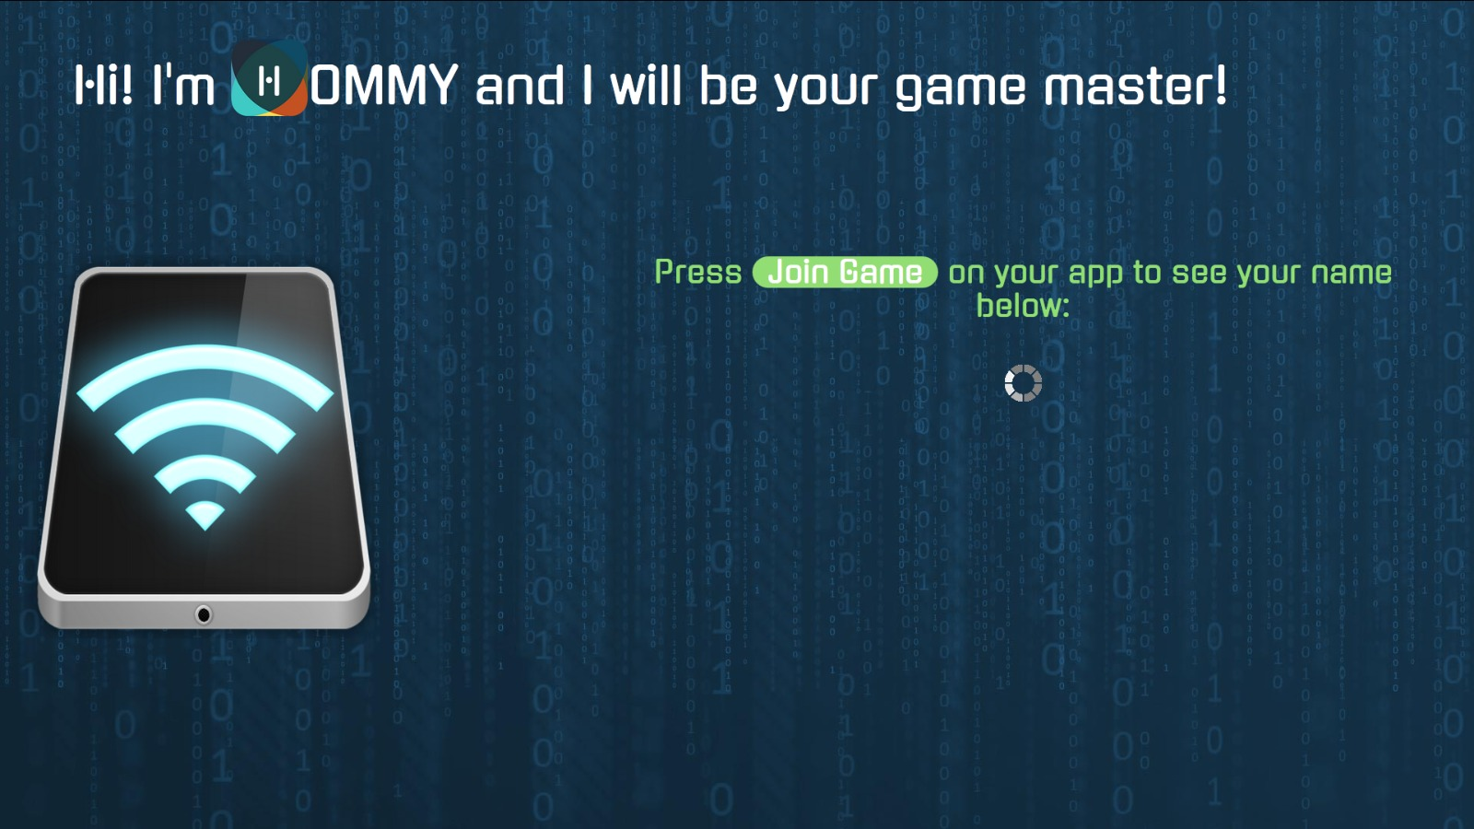

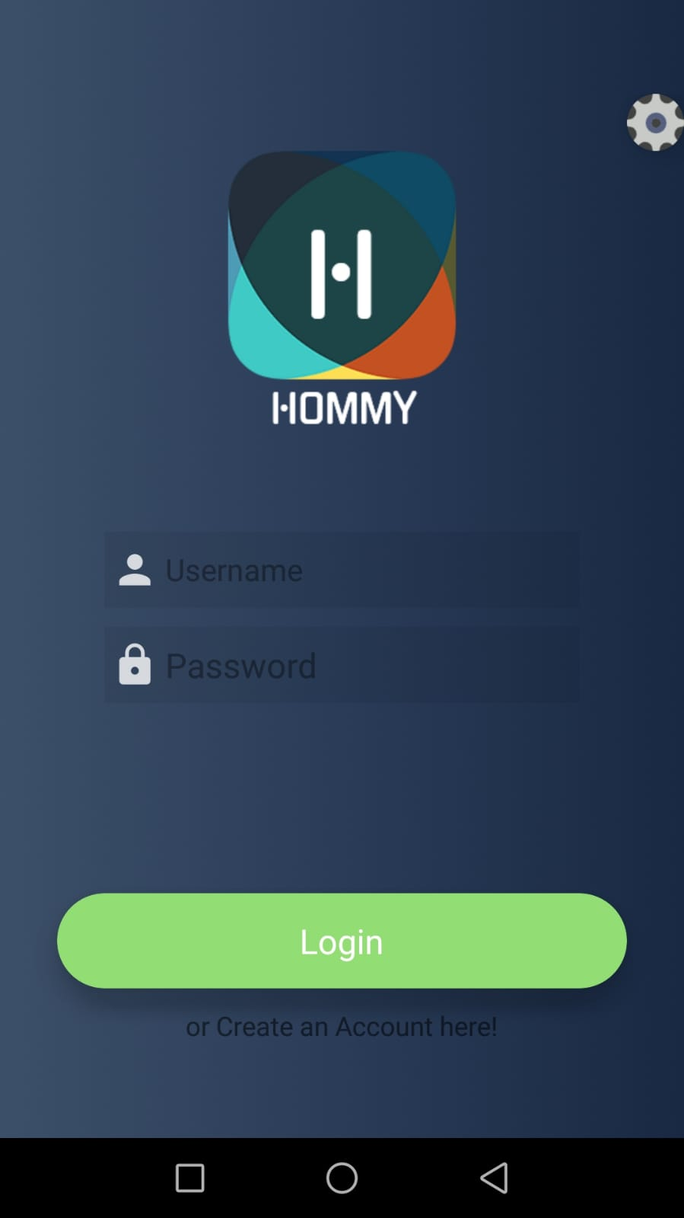

STARTING THE GAME

Slide 8
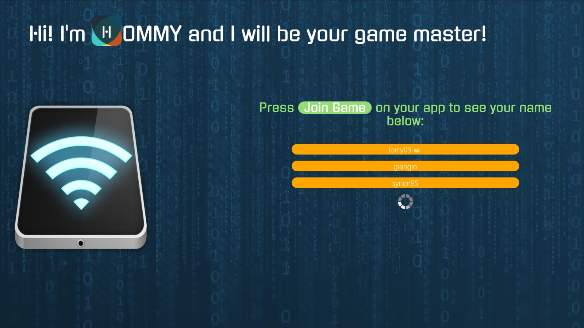
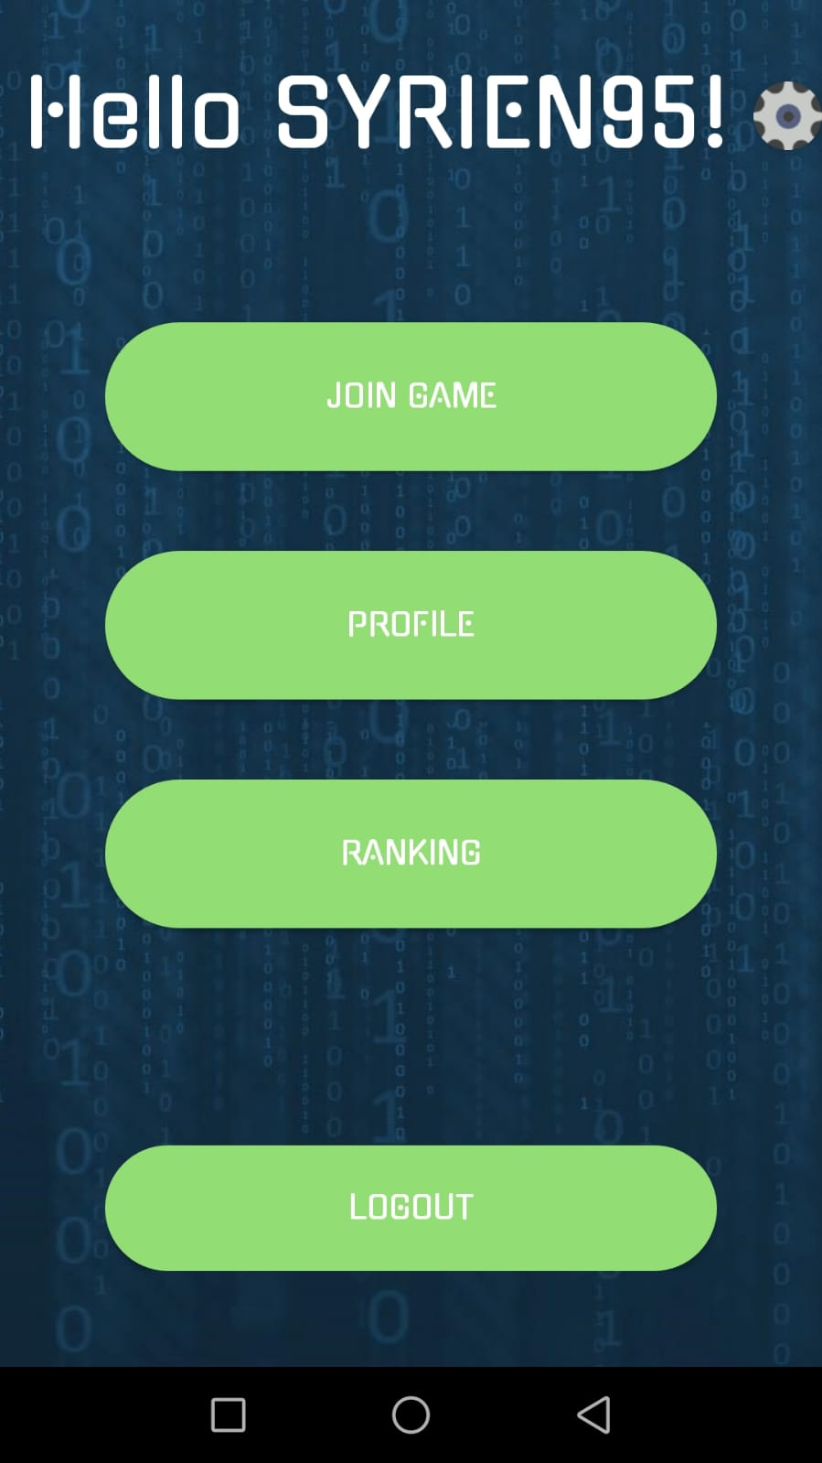
LOG IN

Slide 9

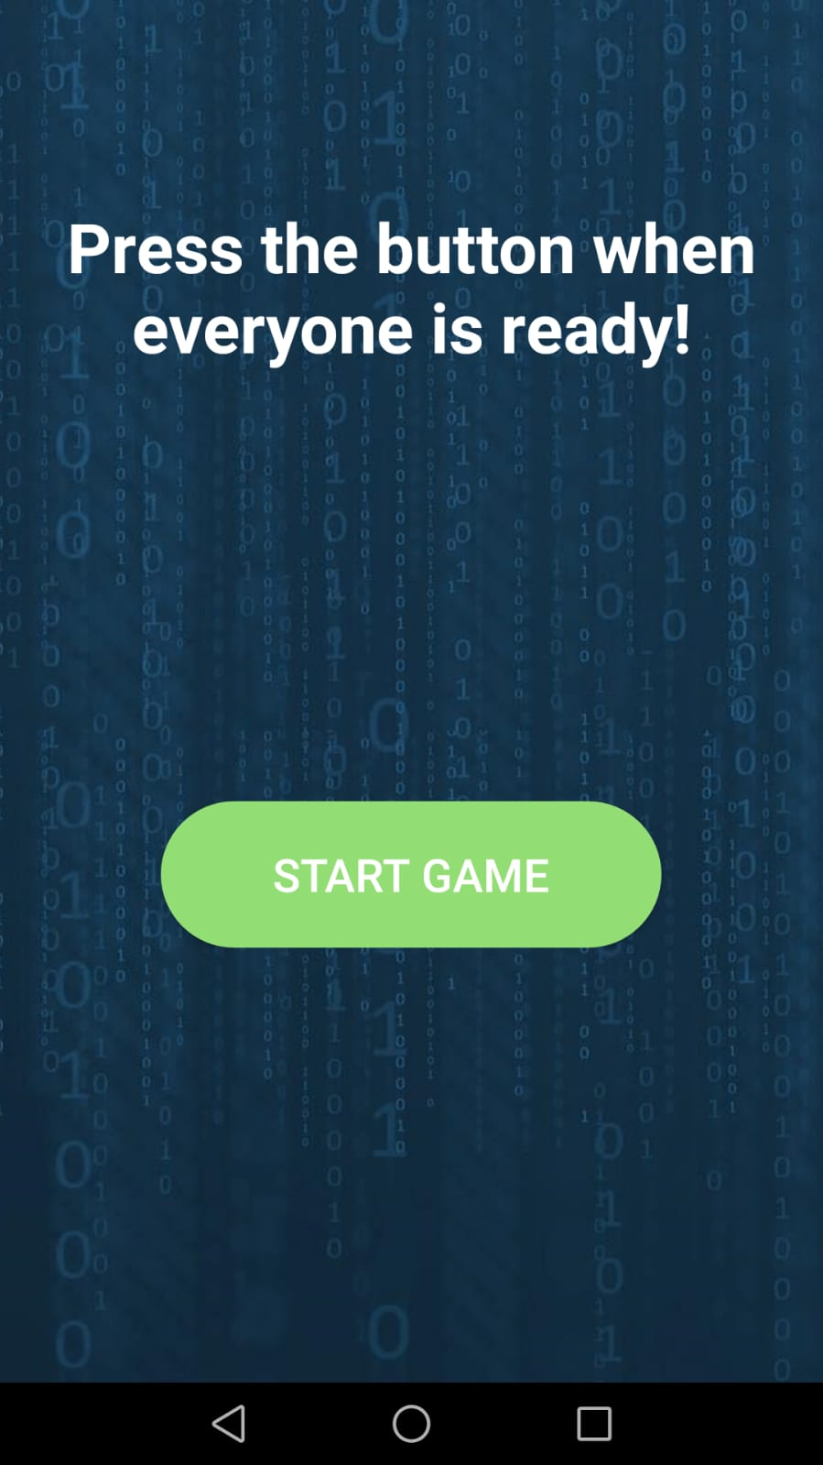

WAITING ROOM

Slide 10
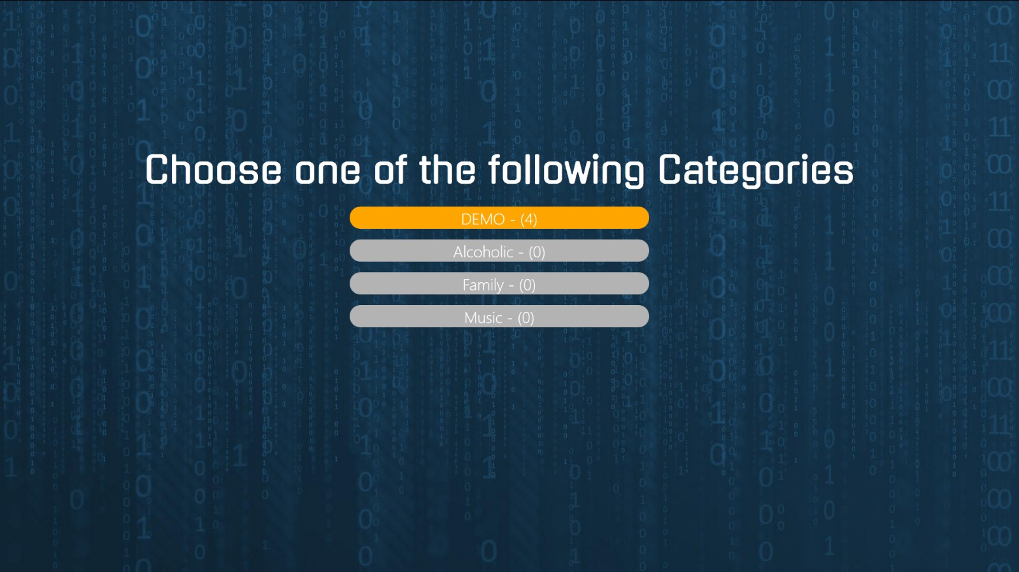

Slide 11
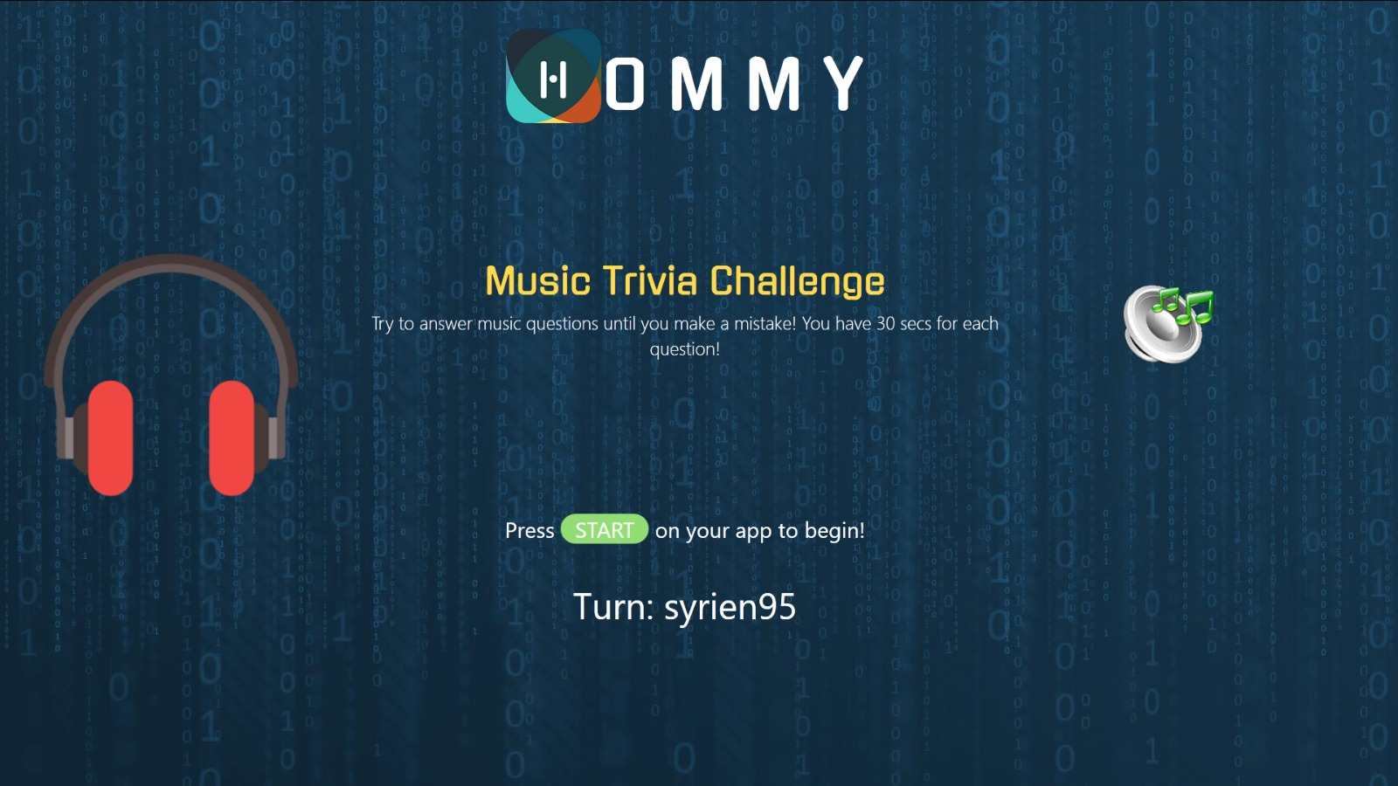
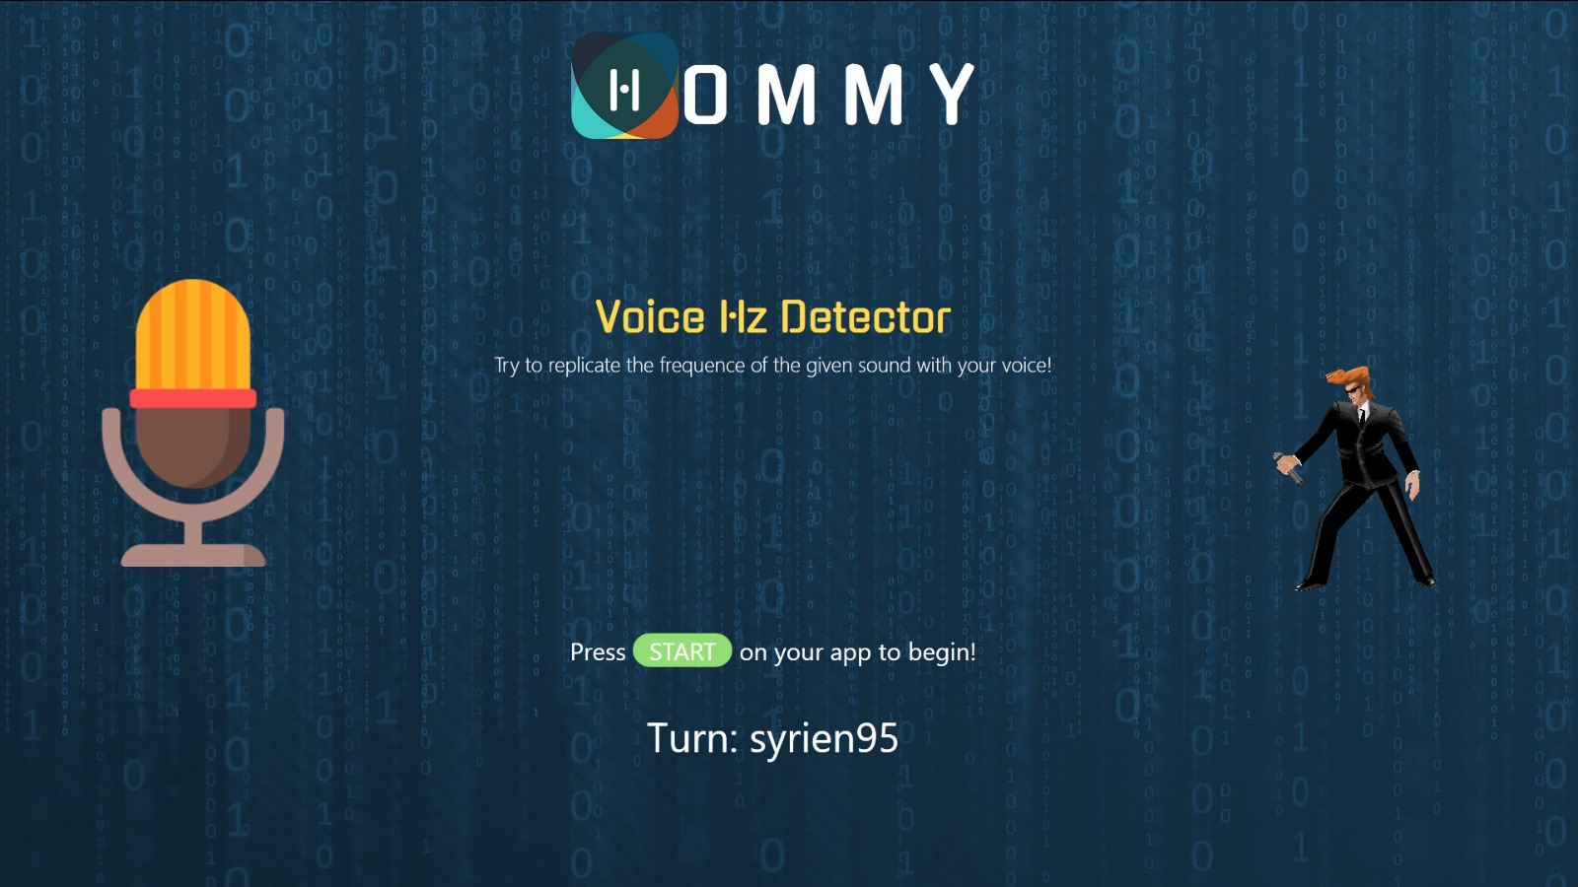
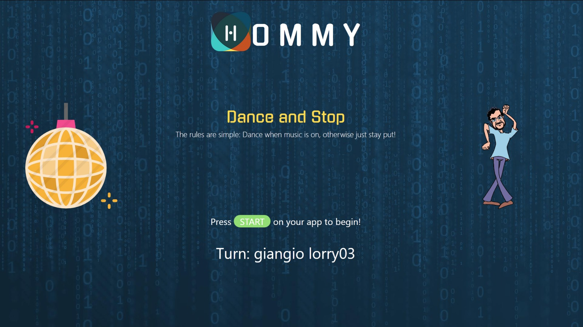
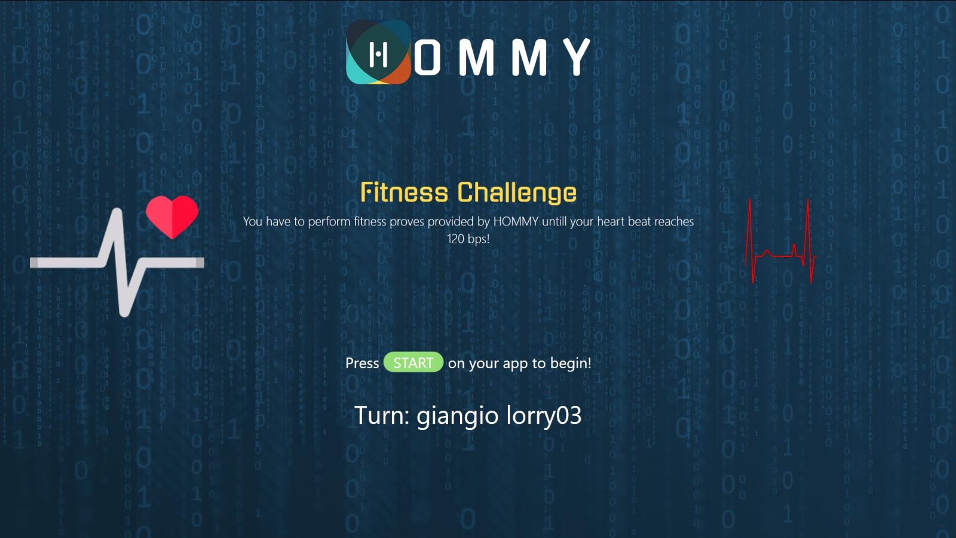
Different score criteria.
RANDOM GAME

Slide 12
SYSTEM ARCHITECTURE

Slide 13
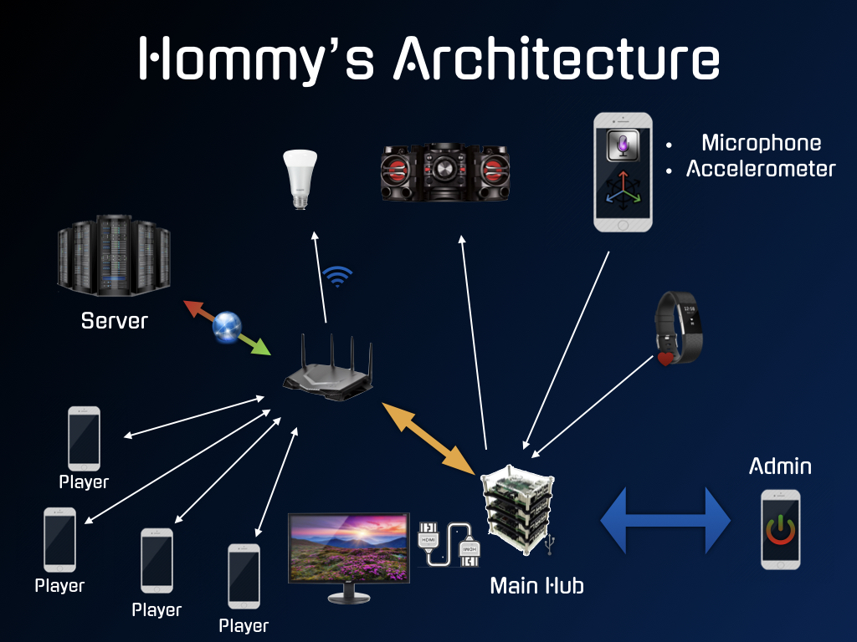

Slide 14
LET’S BE TECHNICAL

Slide 15
MAIN HUB
It will be running on the Pc Hub and will contain all the logic of every single challenge. This Pc works as server for the Mobile App and as client for the Pc Sever hosting the database.

Slide 16
FEATURES
Acquiring starting settings from users.
Speakers and Music control.
Lights setting for each challenge
Randomly selects one challenge after another inside the chosen category.
Sends users' feedback to the database to learn which challenge is the most rated.

Slide 17
USED LIBRARIES
python-vlc
mysql-connector-python
requests
selenium
urllib3
flask
winsound

Slide 18
Graphical User Interface
Web Application as GUI.
HTML,CSS and JAVASCRIPT
Every HTML page is filled dynamically using Jinja2 templating language

Slide 19
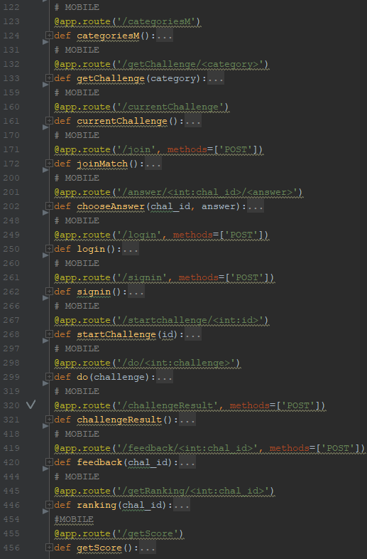
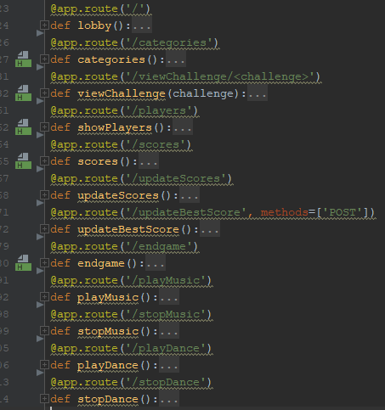
API's LIST
These APIs are called by the mobile App. Their aim is to catch inputs and data from mobiles and to process them according to the logic of the games.
These APIs are called by the browser, through selenium. Their aim is to show the interface, to play music and to update scores.

Slide 20
Main APIs
/viewChallenge/<challenge> -> It takes the challenge id and it renders the challenge template with the correct informations. It send notifies to every smartphone to allow synchronization.
/getChallenge/<category> -> It takes the category name and, through an HTTP request to the online Server, it gets a random challenge paying attention to which one has already been faced. After the choice of the player(s) then it calls /viewChallenge API.
/answer/<int:chal_id>/<answer> -> It takes the challenge id (Only Music Trivia Challenge in this case) and the answer (A,B,C,D) and checks if it is correct or not
/challengeResult -> This API use POST method. A JSON object containing the challenge id and others information depending on the challenge itself (for instance the frequency for the Voice Hz Detector) is passed. For each challenge it calculates the points per player

Slide 21
Classes and Structures
Match.py - Contains attributes about Match information such as the list of player objects, the chosen category and the current challenge. - It provides methods to manipulate and to get these data.
- It also initialize Selenium tool to open the web browser (Firefox in this case).
Player.py - Contains attributes about players information such as the name, the score or the challenges won. - It provides every getters and setters to access and update the data.

Slide 22
Server
It stores the data needed to play each challenge (such as questions and answers of a Trivia challenge). Plus it hosts a list of best-rated challenges to learn users' preferences for future matches. The Server Pc contains the APIs to provide SQL queries.

Slide 23
FEATURES
Stores every needed data for specific challenges;
Stores users' profiles;
Hosts a list of best-rated challenges;
Hosts and provides to the user the list of best scores (associated with the user) for each challenge;
Allows future system-update such as new challenges for HOMMY to download.

Slide 24
SERVER APIs
getRandomChallenge: Checks with the database using sql queries to get one random challenge considering the challenges that has already been played.
getRandomQuiz: Get a random quiz when the music trivia challenge start from the trivia challenge table of the database considering questions already been asked using their IDs.
login: Receives a json object and checks with the profiles table if the user's info exist and are identical, then the user is allowed to enter the app.
ranking: It shows for all the challenges the best scores that have been achieved by the players.

Slide 25
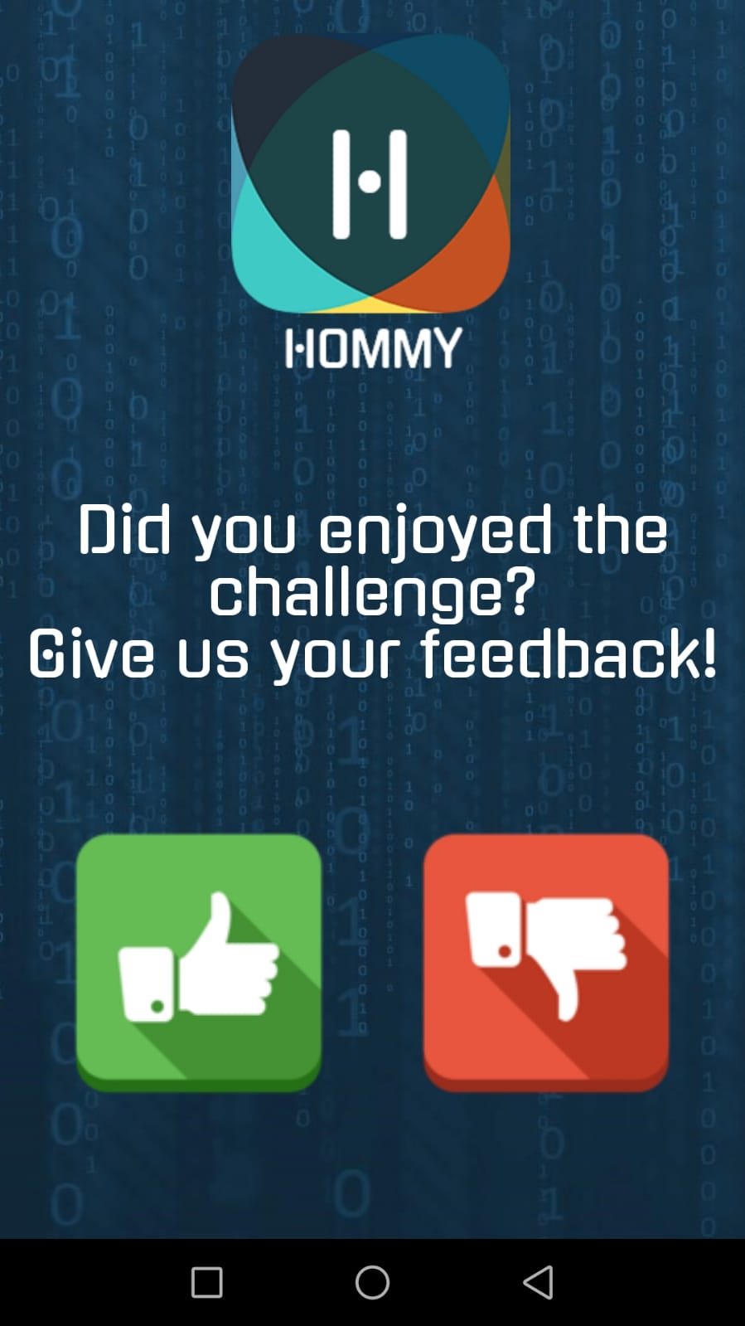
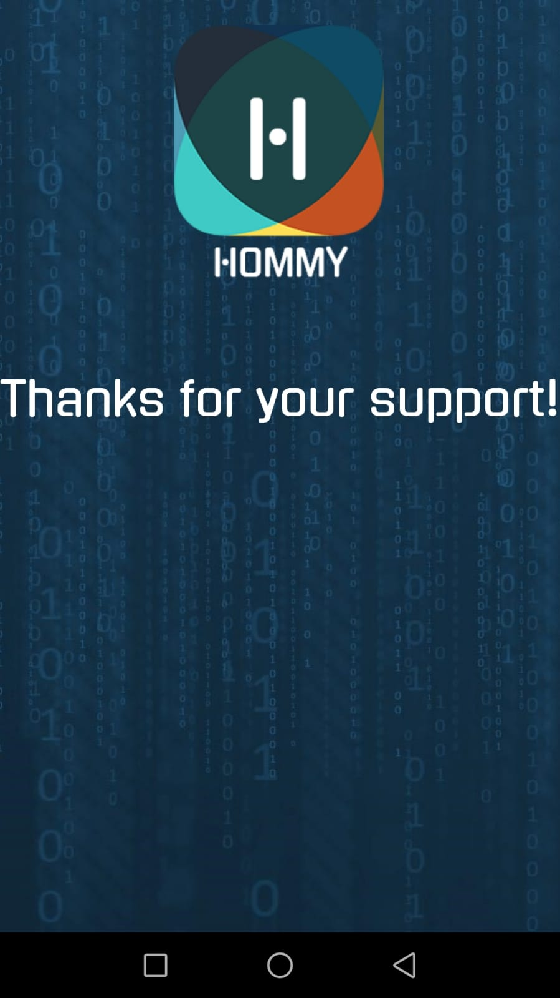
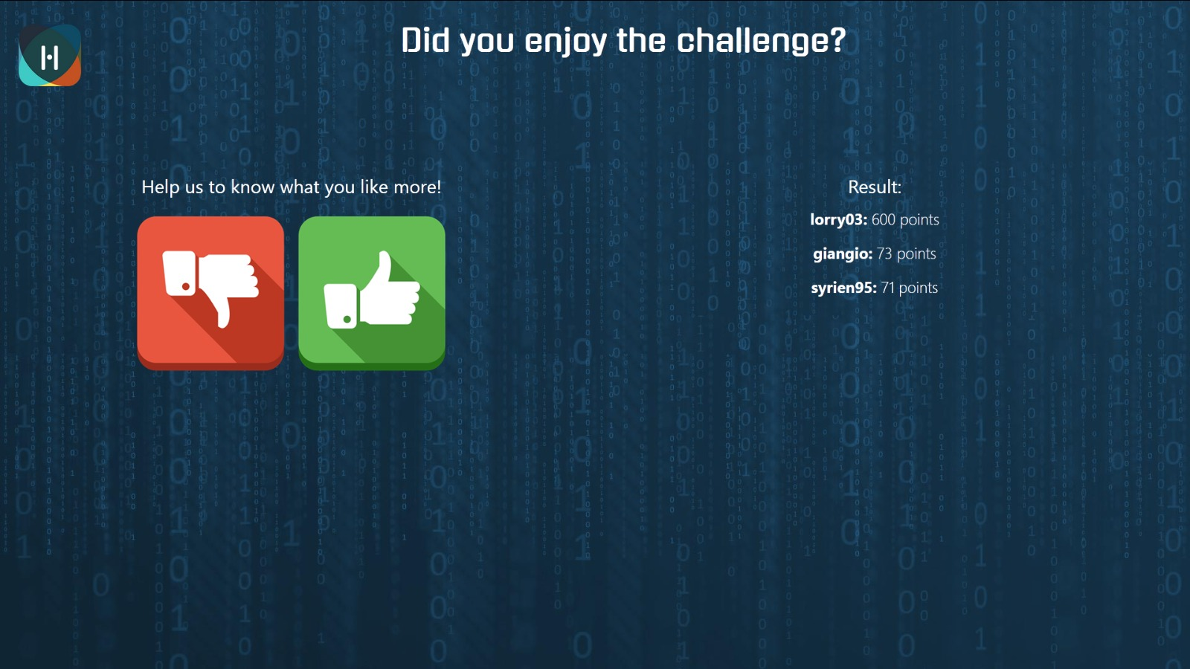
DATA STORAGE
At the end of each challenge, the system ask a feedback about that;
It will storage every like or dislike to have information on the best rates games.

Slide 26
DATABASE
Categories: Names of categories where games are classified into according the their genre;
Challenges: Names of the challenges and the categories they belong to with description about every game;
Profiles: The registered users with their account information;
Profiles-challenges: The best score for each user for a certain challenge;
Trivia Challenge: The multiple choice questions of the trivia challenge with 4 choices for each and its resource.

Slide 27
Android App
Mobile client that allows the users to interact with HOMMY.

Slide 28
FEATURES
Allows the users to create their own profile.
Sends users' inputs to the Main Hub (i.e. settings or answers).
Sends users' feedback at the end of each challenge.
Allows to use some smartphone features such as accelerometer or microphone.

Slide 29

GOOGLE FIREBASE
The Application uses Google Firebase to synchronize
with the Main Hub. Tokens are sent to Google from
the android app and through the same token and Apis
the Main Hub can make Google send a notification to
the app so it can change page and be synchronized.

Slide 30
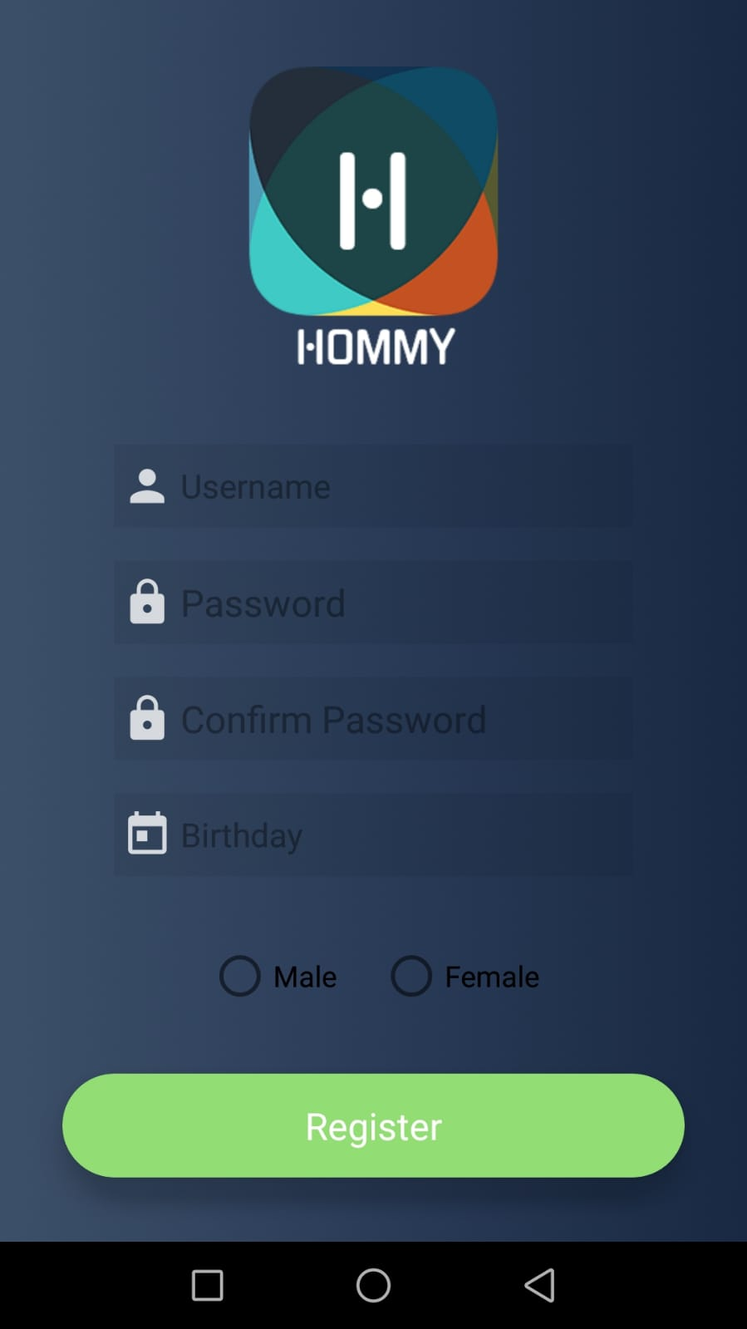
PROFILES
LOG-IN PAGE
NEW ACCOUNT PAGE

Slide 31
PROFILES
SERVER
NEW ACCOUNT PAGE

Slide 32
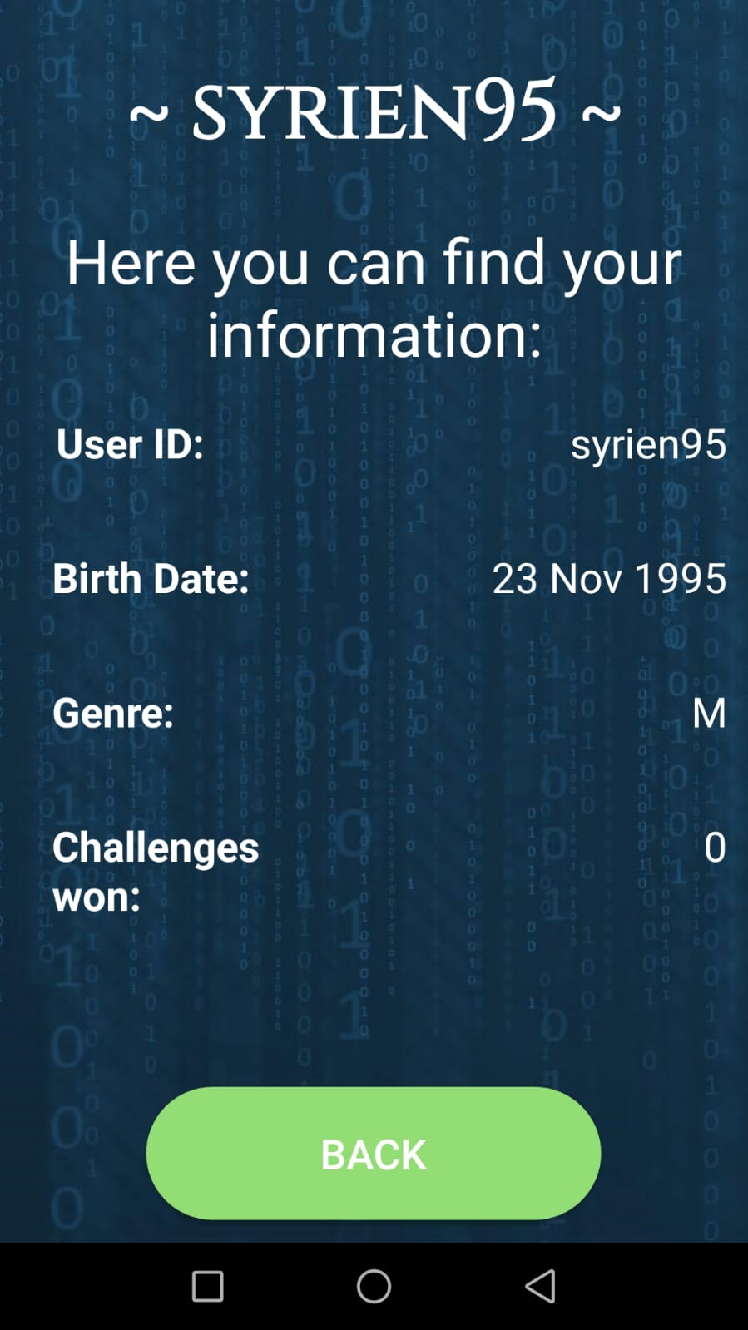
PAGES
SERVER

Slide 33
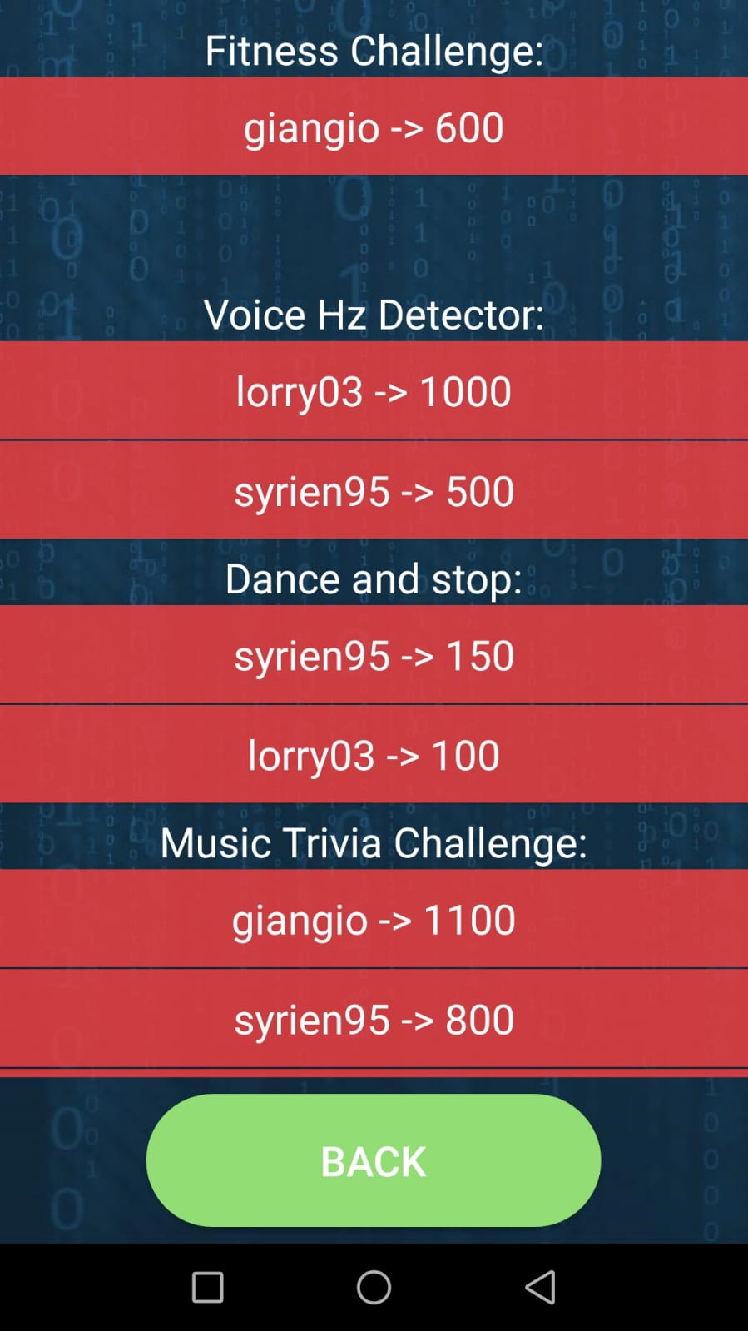
PAGES

Slide 34
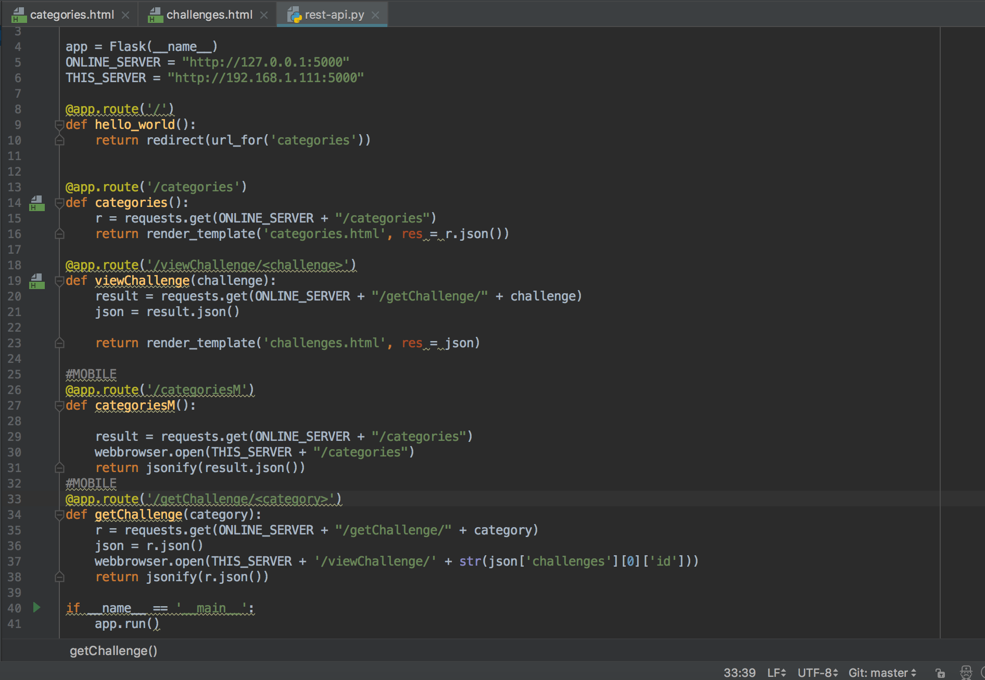
SMARTPHONE SENSORS
MAIN HUB
ACCELEROMETER & MICROPHONE

Slide 35
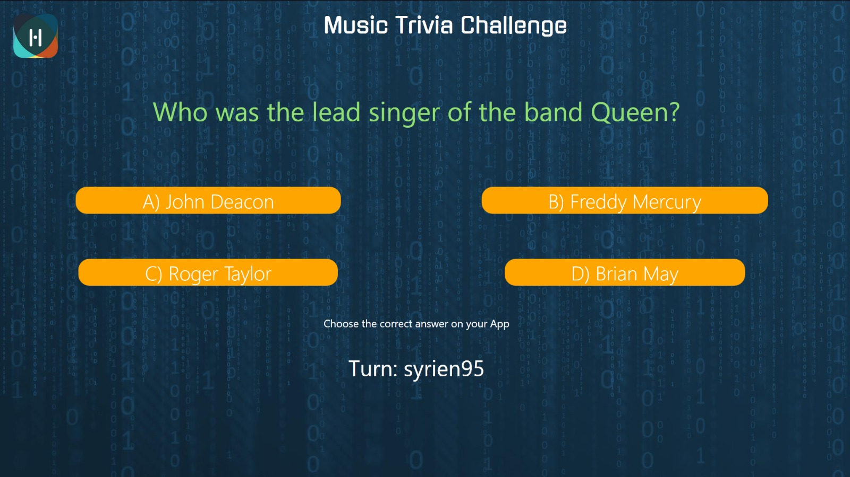
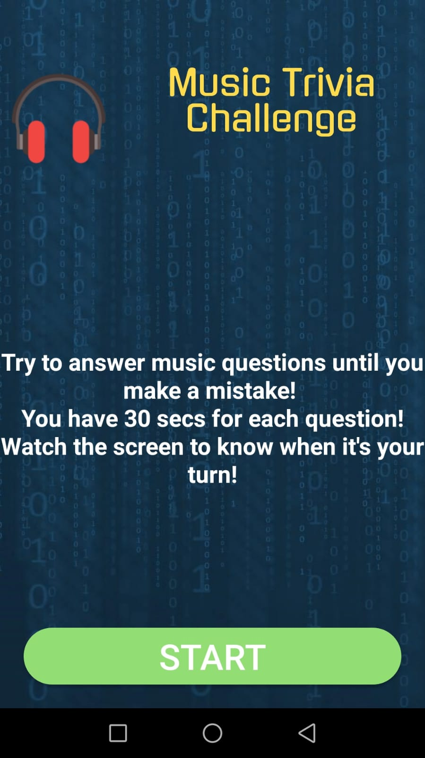
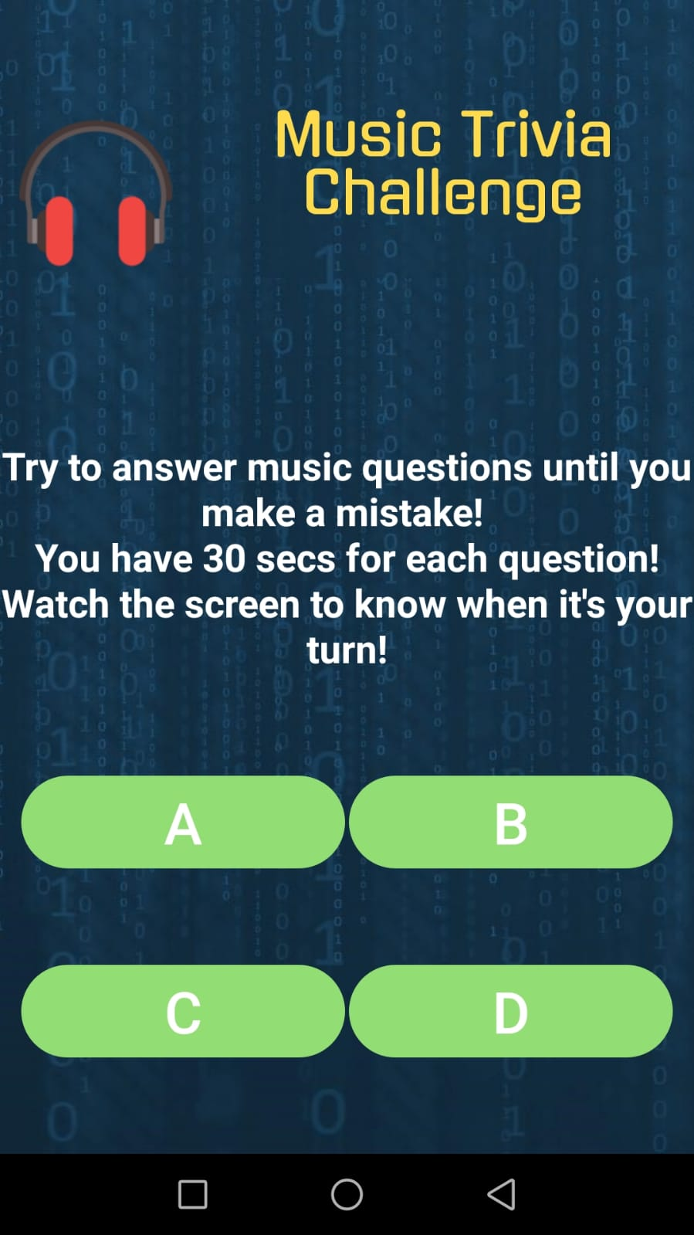
PLAYING
The user needs the smarphone during the game to interact with the system

Slide 36
Games
The system has just four games right now, but ideally it should have a huge library of differents games.
This library will be updated by server

Slide 37




HOMMY’S GAMES
MUSIC TRIVIA CHALLENGE
FITNESS CHALLENGE
DANCE & STOP
VOICE HZ DETECTOR

Slide 38
FITNESS CHALLENGE
The players will have to perform specific fitness exercises randomly chosen by HOMMY. Their heartbeat will be monitored and the last player who reaches a specific threshold will win the challenge.

Slide 39
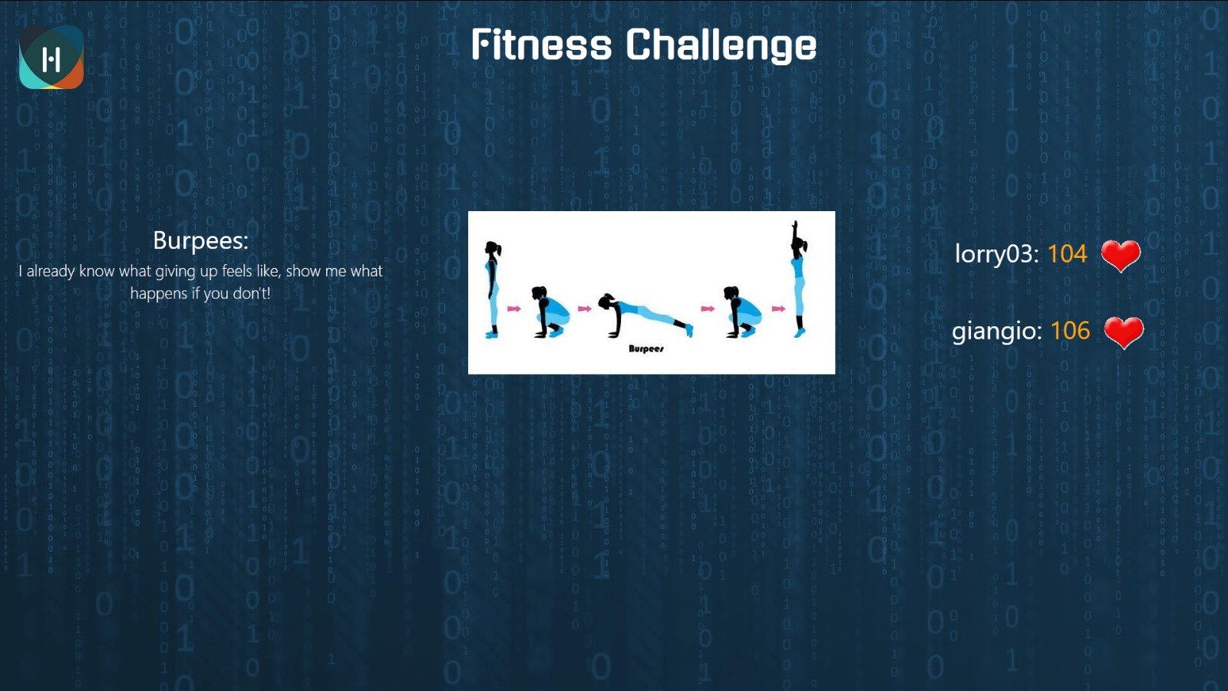
FITNESS CHALLENGE
It should work through a HTTP request (using Fitbit APIs ) but we used a simulation because Fitbits weren't enough to play the challenge and they are not able to capture the heartbeat in real time.
Example of Fitbit Api:
GET https://api.fitbit.com/1/user/-/activities/heart/date/today/1d/1sec/time/00:00/00:01.json

Slide 40
MUSIC TRIVIA CHALLENGE
Thanks to a music database HOMMY will be able to play different songs and will provide different questions and alternative answers. Then, each player will be able to answer through the app on their smartphones.
Every user, during his own turn, will be given questions as long as he answers correctly. In the end, the user with more correct answers wins!

Slide 41
MUSIC TRIVIA CHALLENGE
Players answer to the questions through the smartphone;
The system replies with sounds and lights (green and red).

Slide 42
VOICE HZ DETECTOR
HOMMY will provide musical-note and players have to reproduce the same sound with their voice. HOMMY will compare the original sound with the player’s and decide which one is the most accurate.

Slide 43
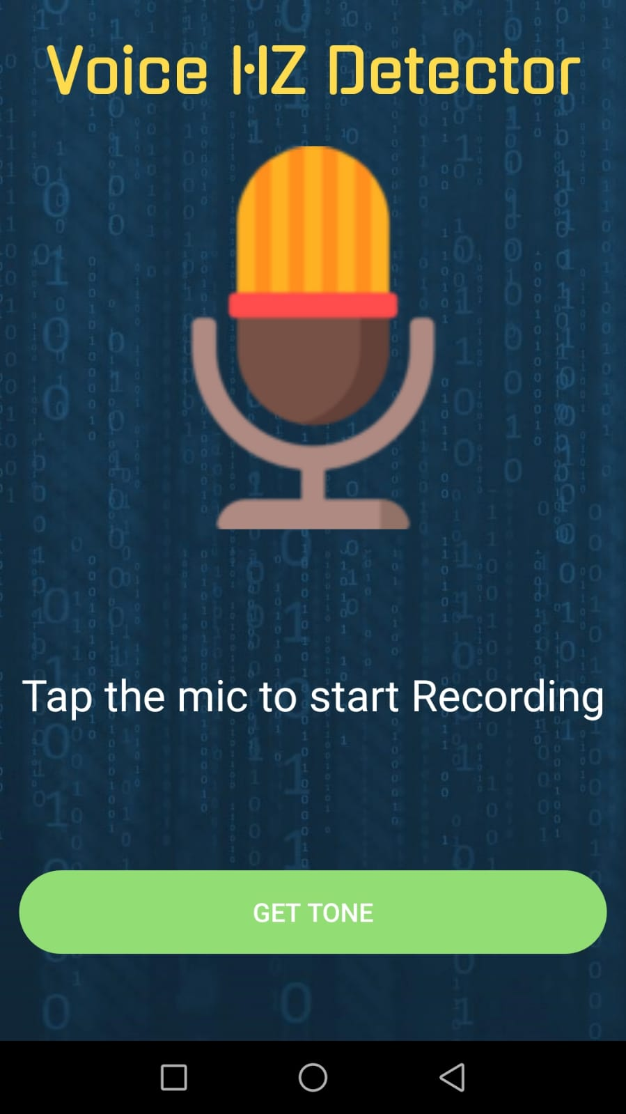
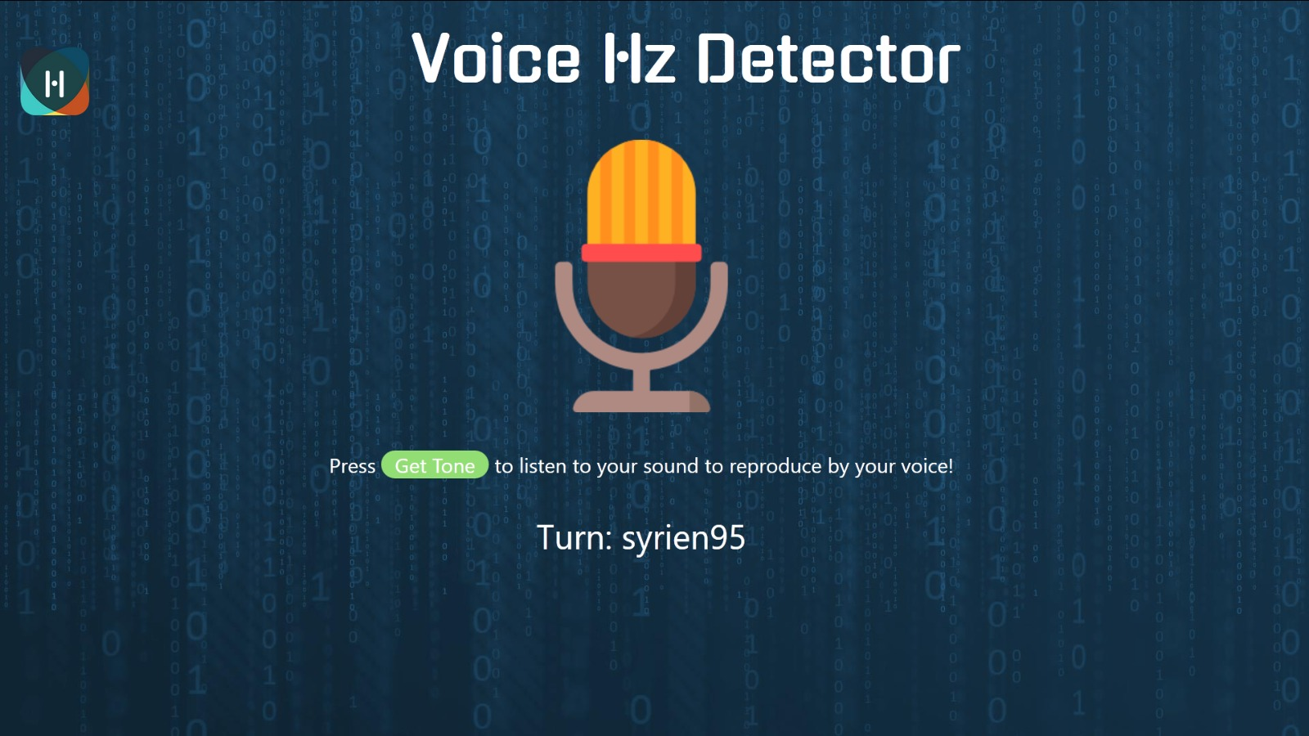
VOICE HZ DETECTOR
A DFT algorithm has been used to analyze frequencies previously recorded by smartphone’s microphone.
The system compare the frequencies and rewards the player according to how similar his voice was.

Slide 44
DANCE & STOP
HOMMY plays music and each player has to dance. Suddenly HOMMY will stop the music and players should be ready to stop themselves. If anyone doesn’t dance while the music is playing or moves once it is stopped, then will lose the challenge.

Slide 45
DANCE & STOP
The system analyzes player’s movements by the smartphone’s accelerometer, then it decides if the player is "moving " based on tolerance parameters.

Slide 46
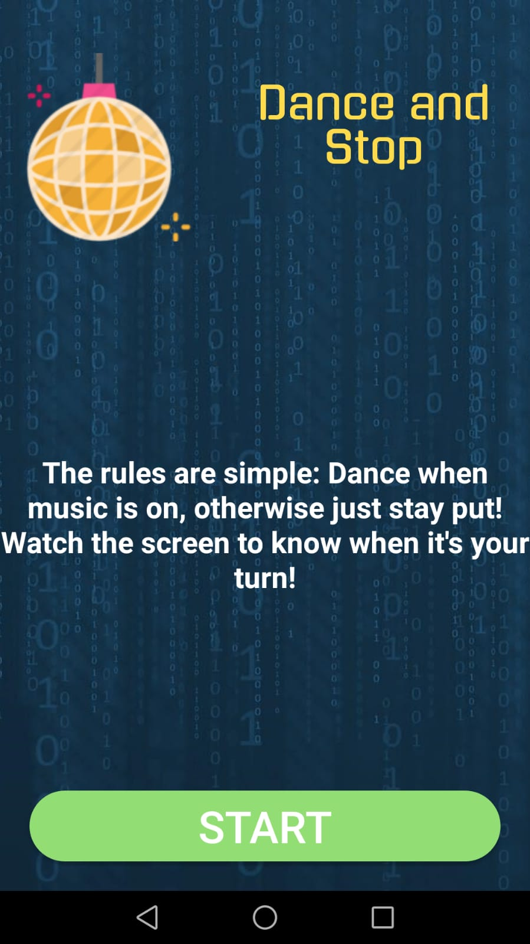
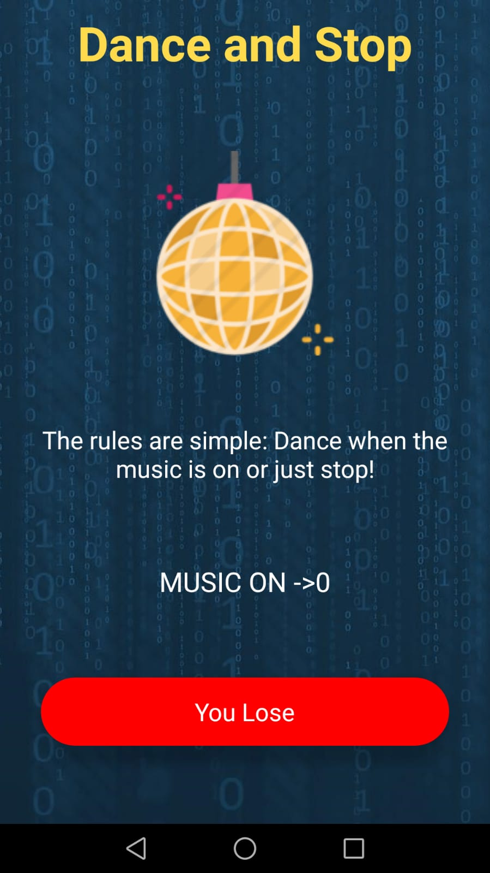
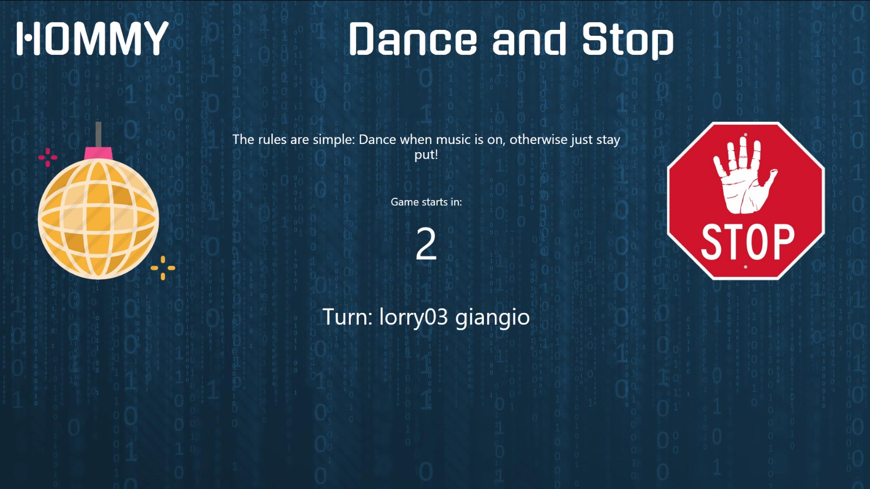
DANCE & STOP

Slide 47
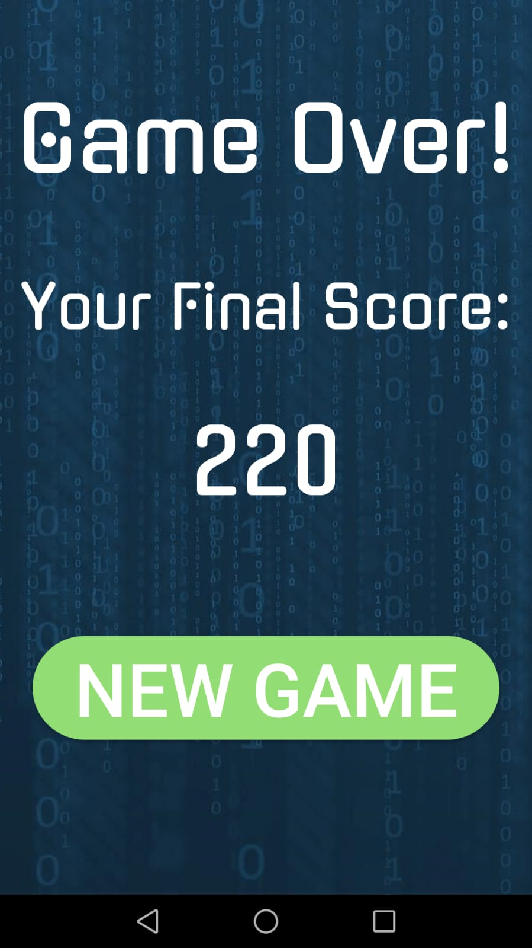
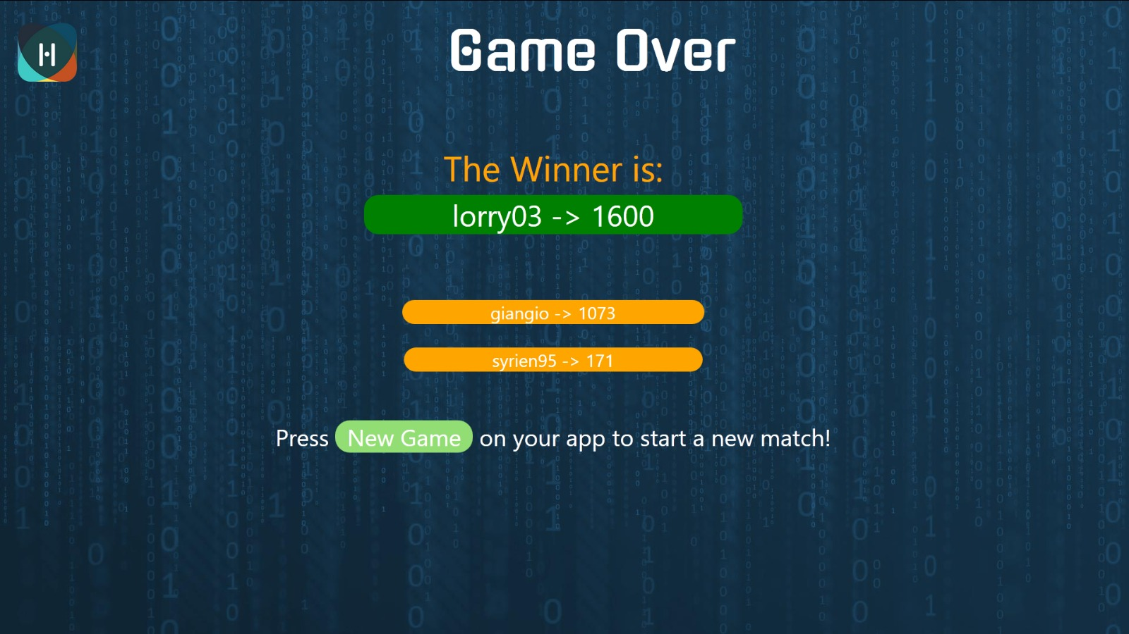
WINNER & LOSERS
At the end of the game, HOMMY counts the points of each challenge and decides who is the winner.

Slide 48
DEMO

Slide 49
HOMMY
Politecnico di Torino
Ambient Intelligence 01QZPLZ

